Slide 1
C1000-c1500 5 a Day

Slide 2
Crime and Punishment c1000-present
Moral Crime
Petty Theft
Maiming
Peasant
Weigild
______________________________________________________________________________________________________________________________________________________________________________________________________________________________________________________________________________________________________________________________________________________________________________________________________
What does source B suggest about William’s role in law and order?
Source B – An extract from Historia Ecclesiastica (Church History) by a priest called Orderic Vitalis, written between 1109 and 1141 to chronicle the history of England through that period.
In his anger he commanded that all crops and herds, chattels and food of every kind be brought together and burned to ashes with consuming fire… As a consequence… so terrible a famine fell upon the humble and defenceless people, that more than 100,000 Christian folk of both sexes, young and old alike, perished of hunger.
Match these statements to the correct time period.
There were three main types of crime against the person, property and authority. | Hanging, drawing and quartering is introduced. | Fines are now paid to the king, not the victim of a crime.
Anglo-Saxon
Norman
Late Medieval

Slide 3
Crime and Punishment c1000-present
Describe 3 minor crimes in Norman England.
1.
2.
3.
___________________________________________ ___________________________________________________________________________________________________________________________________________________________________________________________________________________________________________________________________________________________________________________________________________________________________________________________________ ___________________________________________________________________________________________________________________________________________________________________________________________________________________________________________________________________________________________________________________________________________________________________________________________________
Explain one way in which punishment changed from the Anglo-Saxon period to the late Middle Ages. [4 Marks]

Slide 4
Crime and Punishment c1000-present
Crime
Punishment
Law Enforcement
King’s Peace
Treason
Feature 1: ________________________________________________________________________________________________________________________________________________________________________________________________________________________________________________________________________________________________________________________________________________________ Feature 2: ________________________________________________________________________________________________________________________________________________________________________________________________________________________________________________________________________________________________________________________________________________________
Describe two features of law and order in Norman England. [4 Marks]
Match these events to the correct time period.
Trial by ordeal comes to and end. | William I is crowned king of England. | Richard I introduces coroners to investigate suspicious deaths
1066
1194
1215

Slide 5
Crime and Punishment c1000-present
_______________________________________ ______________________________________________________________________________________________________________________________________________________________________________________________________________________________________________________________________________________________________________________________________________________________________________________________________
Describe 3 punishments from the Anglo-Saxon period.
1.
2.
3.
What can you learn about the authority of Justices of the Peace from Source D?
Source D – An extract from a statute passed in 1344 ‘Guardians of the Peace’ was the original name for Justices of the Peace.
The most substantial persons in the counties shall be appointed Guardian of the peace by commission of the king and whenever need may require… [shall] hear and determine felonies and trespasses [major and minor crimes] against the peace, in the same countries, and inflict reasonable punishment.

Slide 6
Crime and Punishment c1000-present
Crimes Against a Person
Crimes Against Property
Collective Responsibility
Oath
Capital Punishment
Describe 3 punishments from the Norman period.
1.
2.
3.
Match these statements to the correct time period.
Murdrum (a fine paid when an Anglo-Saxon murdered a Norman) was introduced. | The role of parliament in law-making was increasing. | The hue and cry was initially established in this time period.
Anglo-Saxon
Norman
Late Medieval

Slide 7
Crime and Punishment c1000-present
Worth 2 tasks
_________________________________________________________________________________________________________________________________________________________________________________________________________________________________________________________________________________________________________________________________________________________________________________________________________________________________________________________________________________________________________________________________________________________________________________________________________________________________________________________________________________________________________________________
________________________________________________________________________________________________________________________________________________________________________________________________________________________________________________________________________________________________________________________________________________________________________________________________________________________________________________________________________________________________________________________________________________________________________________________________________________________________________________________________________________________________________________________________________________________________________________________________________________________________________________________________________________________________________________________________________________________________________________________________________________________
Explain why there were changes to crime and punishment from Anglo-Saxon to Early Middle Ages England. [12 Marks]
You may use the following in your answer:
• Murdrum
• Trial by Jury
You must also use information of your own.
What other things
could you include?

Slide 8
Crime and Punishment c1000-present
Heresy
Murdrum
Deterrent
Retribution
Corporal Punishment
List 3 ways that the role of government was extended in law enforcement in the later Middle Ages:
1.
2.
3.
Match these events to the correct time period.
Forest Laws are introduced. | Henry Tudor becomes King Henry VII. | Domesday Book was created.
1072
1086
1485

Slide 9
Crime and Punishment c1000-present
Worth 2 tasks
_________________________________________________________________________________________________________________________________________________________________________________________________________________________________________________________________________________________________________________________________________________________________________________________________________________________________________________________________________________________________________________________________________________________________________________________________________________________________________________________________________________________________________________________
________________________________________________________________________________________________________________________________________________________________________________________________________________________________________________________________________________________________________________________________________________________________________________________________________________________________________________________________________________________________________________________________________________________________________________________________________________________________________________________________________________________________________________________________________________________________________________________________________________________________________________________________________________________________________________________________________________________________________________________________________________________
Explain why the Normans made changes to crimes and punishments after the Norman Conquest. [12 Marks]
You may use the following in your answer:
The Forest Laws
The murdrum fine.
You must also use information of your own.
What other things
could you include?

Slide 10
Crime and Punishment c1000-present
Clergy
Secular
Sanctuary
High Treason
Banished
Describe 3 ways that the church influenced the Middle Ages.
1.
2.
3.
Match these events to the correct time period.
Justices of the peace appointed for all areas. | Murdrum fine introduced for killing Normans. | Henry II reorganises courts and tries to limit powers of the church.
1070
1194
1327

Slide 11
Crime and Punishment c1000-present
Worth 2 tasks
_________________________________________________________________________________________________________________________________________________________________________________________________________________________________________________________________________________________________________________________________________________________________________________________________________________________________________________________________________________________________________________________________________________________________________________________________________________________________________________________________________________________________________________________
________________________________________________________________________________________________________________________________________________________________________________________________________________________________________________________________________________________________________________________________________________________________________________________________________________________________________________________________________________________________________________________________________________________________________________________________________________________________________________________________________________________________________________________________________________________________________________________________________________________________________________________________________________________________________________________________________________________________________________________________________________________
Explain why ‘trial by ordeal’ was used c1000-c1200. [12 Marks]
You may use the following in your answer:
Trial by hot iron
Church courts
You must also use information of your own.
What other things
could you include?

Slide 12
C1500-c1700 5 a Day

Slide 13
Crime and Punishment c1000-present
Excommunicate
Recant
Poor Relief
Vagabondage
Decriminalise
___________________________________________ ___________________________________________________________________________________________________________________________________________________________________________________________________________________________________________________________________________________________________________________________________________________________________________________________________ ___________________________________________________________________________________________________________________________________________________________________________________________________________________________________________________________________________________________________________________________________________________________________________________________________
Explain one way that definitions of crime changed between 1500 and 1700. [4 Marks]
Match these monarch to the correct period.
James I | Henry VIII | Elizabeth I
1509-1547
1558-1603
1603-1625

Slide 14
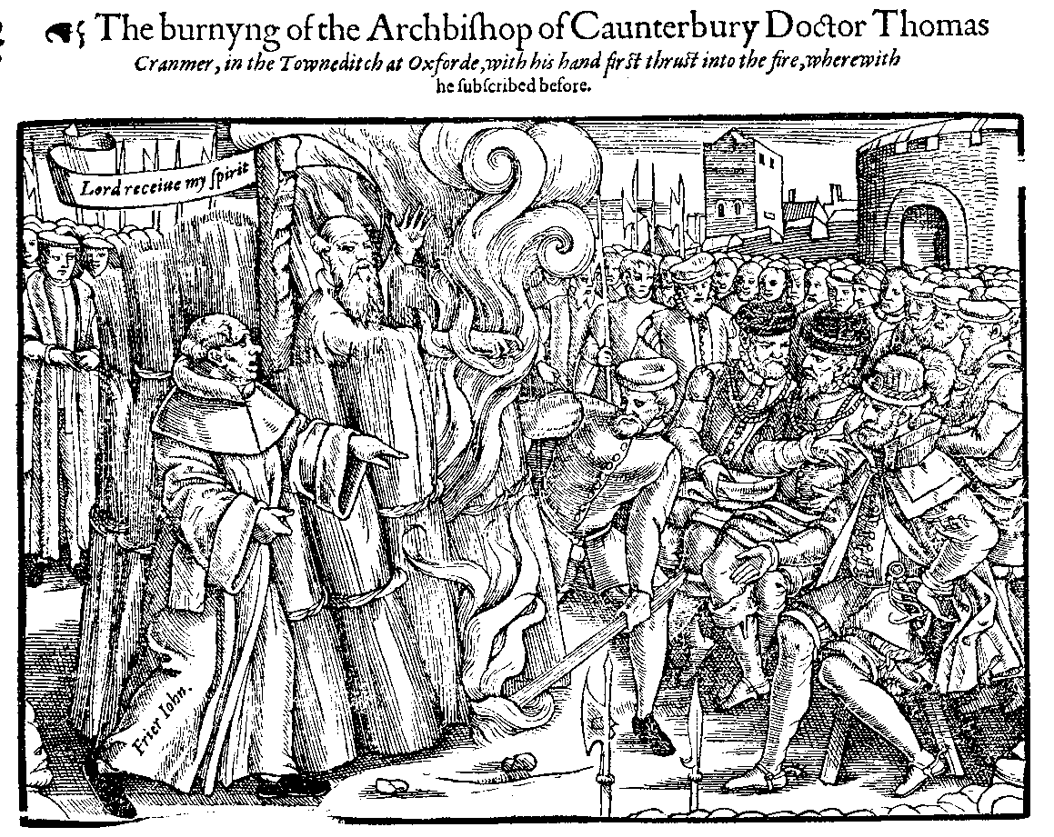
Crime and Punishment c1000-present
Describe the new puritan ‘moral’ laws.
1.
2.
3.
______________________________________________________________________________________________________________________________________________________________________________________________________________________________________________________________________________________________________________________________________________________________________________________________________
Describe what is happening in the source below and explain why this was taking place.

Slide 15
Crime and Punishment c1000-present
Pardon
Transportation
Colonies
Rehabilitation
Bloody Code
Describe the new role of the:
Town Constable -
Night Watchmen -
Match these events to the correct period.
Jonathan Wild (an infamous thief was executed). | By this date in the 17th century alone, 50 capital crimes were committed. | Bridewell Prison opened.
1556
1688
1725

Slide 16
Crime and Punishment c1000-present
Worth 2 tasks
_________________________________________________________________________________________________________________________________________________________________________________________________________________________________________________________________________________________________________________________________________________________________________________________________________________________________________________________________________________________________________________________________________________________________________________________________________________________________________________________________________________________________________________________
________________________________________________________________________________________________________________________________________________________________________________________________________________________________________________________________________________________________________________________________________________________________________________________________________________________________________________________________________________________________________________________________________________________________________________________________________________________________________________________________________________________________________________________________________________________________________________________________________________________________________________________________________________________________________________________________________________________________________________________________________________________
‘In the period 1500-1700, the main aim of changes to punishment was retribution.’ [16 Marks]
How far do you agree? Explain your answer. You may use the following in your answer:
The Bloody Code
Transportation to America
You must also use information of your own.
What other things
could you include?

Slide 17
Crime and Punishment c1000-present
Conspirator
Catholic
Protestant
Witchcraft
Demonologie
List three reasons Catholics had to overthrow King James I.
1.
2.
3.
Match these events to the correct period.
Guy Fawkes and other conspirators are executed. | James I becomes king of England. | 5th November Gunpowder Plot.
1603
1605
1606

Slide 18
Crime and Punishment c1000-present
Parliament
Guy Fawkes
Pact
Superstition
Enlightenment
___________________________________________ ___________________________________________________________________________________________________________________________________________________________________________________________________________________________________________________________________________________________________________________________________________________________________________________________________ ___________________________________________________________________________________________________________________________________________________________________________________________________________________________________________________________________________________________________________________________________________________________________________________________________
Explain one way that punishments changed from the 11th Century to the 17th. [4 Marks]
Match these events to the correct period.
King James wrote Demonologie. | Henry VIII introduced the Witchcraft Act. | The Royal Society was founded.
1542
1597
1660

Slide 19
Crime and Punishment c1000-present
List three reasons why women were more likely than men to be accused of witchcraft.
1.
2.
3.
___________________________________________ ___________________________________________________________________________________________________________________________________________________________________________________________________________________________________________________________________________________________________________________________________________________________________________________________________ ___________________________________________________________________________________________________________________________________________________________________________________________________________________________________________________________________________________________________________________________________________________________________________________________________
Explain one way that the law changed from the 11th Century to the 17th. [4 Marks]

Slide 20
C1700-c1900 5 a Day

Slide 21
Crime and Punishment c1000-present
Martyr
The Hawkhurst Gang
Import Duties
Home Secretary
William Pitt
Detail change and continuity for the following:
Smuggling -
Highway Robbery -
Poaching -
Match these events to the correct period.
Import taxed cut, large-scale smuggling reduced. | Black Act makes poaching game or damaging forest a capital crime. | Last known execution for witchcraft.
1716
1723
1850

Slide 22
Crime and Punishment c1000-present
Worth 2 tasks
_________________________________________________________________________________________________________________________________________________________________________________________________________________________________________________________________________________________________________________________________________________________________________________________________________________________________________________________________________________________________________________________________________________________________________________________________________________________________________________________________________________________________________________________
________________________________________________________________________________________________________________________________________________________________________________________________________________________________________________________________________________________________________________________________________________________________________________________________________________________________________________________________________________________________________________________________________________________________________________________________________________________________________________________________________________________________________________________________________________________________________________________________________________________________________________________________________________________________________________________________________________________________________________________________________________________
Why did the problem of highway robbery increase and decrease in the period 1700-1900? [12 Marks]
You may use the following in your answer:
Increased wealth
The death penalty
You must also use information of your own.
What other things
could you include?

Slide 23
Crime and Punishment c1000-present
Inhumane
Transportation
Execution
Convict
Humanitarianism
Describe three common views about prison:
1.
2.
3.
Match these events to the correct period.
National Prison Department takes overall control of the prison system. | Capital Punishment Amendment Act ends public execution. | Transportation to Australia is introduced.
1778
1850
1868

Slide 24
Crime and Punishment c1000-present
Worth 2 tasks
_________________________________________________________________________________________________________________________________________________________________________________________________________________________________________________________________________________________________________________________________________________________________________________________________________________________________________________________________________________________________________________________________________________________________________________________________________________________________________________________________________________________________________________________
________________________________________________________________________________________________________________________________________________________________________________________________________________________________________________________________________________________________________________________________________________________________________________________________________________________________________________________________________________________________________________________________________________________________________________________________________________________________________________________________________________________________________________________________________________________________________________________________________________________________________________________________________________________________________________________________________________________________________________________________________________________
Why was transportation used a punishment in the period c1600-c1850 [12 Marks]
You may use the following in your answer:
American Colonies
Convict Labourers
You must also use information of your own.
What other things
could you include?

Slide 25
Crime and Punishment c1000-present
Bow Street Runners
Metropolitan Police Act
Rural Constabulary Act
Middlesex Justices Act
Municipal Corporations Act
___________________________________________ ___________________________________________________________________________________________________________________________________________________________________________________________________________________________________________________________________________________________________________________________________________________________________________________________________ ___________________________________________________________________________________________________________________________________________________________________________________________________________________________________________________________________________________________________________________________________________________________________________________________________
Explain one way in which policing was similar in Tudor England and the early 18th Century. [4 Marks]
Match these events to the correct period.
Fielding brothers set up the Bow Street Runners. | Criminal Investigations Department is set up. | Police Act makes it compulsory for towns and counties to set up a police force.
1748
1856
1878

Slide 26
Crime and Punishment c1000-present
Penal
Psychosis
Pentonville Prison
Robert Peel
Joshua Jebb
___________________________________________ ___________________________________________________________________________________________________________________________________________________________________________________________________________________________________________________________________________________________________________________________________________________________________________________________________ ___________________________________________________________________________________________________________________________________________________________________________________________________________________________________________________________________________________________________________________________________________________________________________________________________
Explain one difference between the work of the Metropolitan Police office and a night watchman. [4 Marks]
Match these events to the correct period.
Prison Act emphasises rehabilitation and reform of prisoners. | Government inspectors appointed to check prisons. | All prisons brought under control of National Prison Commission.
1835
1877
1898

Slide 27
Crime and Punishment c1000-present
Describe three aspects of the separate system that led prisoners to suffer from mental illness:
1.
2.
3.
___________________________________________ ___________________________________________________________________________________________________________________________________________________________________________________________________________________________________________________________________________________________________________________________________________________________________________________________________ ___________________________________________________________________________________________________________________________________________________________________________________________________________________________________________________________________________________________________________________________________________________________________________________________________
Why is Robert Peel sometimes called the ‘father of modern policing’?

Slide 28
C1900-Present 5 a Day

Slide 29
Crime and Punishment c1000-present
Hate Crime
Homophobic
People-trafficking
Cybercrime
Fraud
Give three examples of cybercrime:
1.
2.
3.
Match these events to the correct period.
Law recognises rap within marriage as a crime. | Modern Slavery Act. | Sexual Offences Act.
1967
1991
2015

Slide 30
Crime and Punishment c1000-present
Worth 2 tasks
_________________________________________________________________________________________________________________________________________________________________________________________________________________________________________________________________________________________________________________________________________________________________________________________________________________________________________________________________________________________________________________________________________________________________________________________________________________________________________________________________________________________________________________________
________________________________________________________________________________________________________________________________________________________________________________________________________________________________________________________________________________________________________________________________________________________________________________________________________________________________________________________________________________________________________________________________________________________________________________________________________________________________________________________________________________________________________________________________________________________________________________________________________________________________________________________________________________________________________________________________________________________________________________________________________________________
‘Types of crimes have not changed since the beginning of the 19th century, only the methods used to commit them.’ [12 Marks]
You may use the following in your answer:
Fraud
Race crimes
You must also use information of your own.
What other things
could you include?

Slide 31
Crime and Punishment c1000-present
Injunction
Domestic Violence
Copyright Theft
Terrorism
Extortion
___________________________________________ ___________________________________________________________________________________________________________________________________________________________________________________________________________________________________________________________________________________________________________________________________________________________________________________________________ ___________________________________________________________________________________________________________________________________________________________________________________________________________________________________________________________________________________________________________________________________________________________________________________________________
Explain one way crimes have stayed the same from the 17th Century to Modern England. [4 Marks]
Match these events to the correct period.
Criminal Justice Act raises severity of ‘hate crimes’. | Terrorism Act. | Abortion Act and Race Relations Act passed.
1968
2000
2005

Slide 32
Crime and Punishment c1000-present
Describe social crimes in the 20th and 21st Century:
Driving Offences -
Drug-Taking -
Feature 1: ________________________________________________________________________________________________________________________________________________________________________________________________________________________________________________________________________________________________________________________________________________________ Feature 2: ________________________________________________________________________________________________________________________________________________________________________________________________________________________________________________________________________________________________________________________________________________________
Describe two features of crime in Modern England. [4 Marks]

Slide 33
Crime and Punishment c1000-present
PSCO
Vigilante
Active Citizenship
CCTV
Neighbourhood Watch
___________________________________________ ___________________________________________________________________________________________________________________________________________________________________________________________________________________________________________________________________________________________________________________________________________________________________________________________________ ___________________________________________________________________________________________________________________________________________________________________________________________________________________________________________________________________________________________________________________________________________________________________________________________________
Explain one way that the system of community and law enforcement in the 20th century was different from community law enforcement in the 16th century.[4 Marks]
Match these events to the correct period.
The Police National Computer is launched. It can hold 25 million records. | The Fingerprint Branch is set up. | First murder convictions based on DNA samples from the victims and accused.
1901
1980
1988

Slide 34
Crime and Punishment c1000-present
Describe three new uses of technology introduced by the police in the 20th Century:
1.
2.
3.
___________________________________________ ___________________________________________________________________________________________________________________________________________________________________________________________________________________________________________________________________________________________________________________________________________________________________________________________________ ___________________________________________________________________________________________________________________________________________________________________________________________________________________________________________________________________________________________________________________________________________________________________________________________________
What does Bill Pitt say, in Source F, about the reasons why Neighbourhood Watch was needed?
Source F – Bill Pitt MP, speaking about the Neighbourhood Watch scheme in a House of Commons debate on 28 February 1983.
We have reached a crux. Crime is growing and we are seen as losing the battle as Sir Kenneth Newman says…I welcome his suggestion that the community should play its par in conquering crime. I welcome the neighbourhood watch. I had strong reservations…because I wondered whether some people would set up vigilant groups.

Slide 35
Crime and Punishment c1000-present
Abolished
Liberal
Timothy Evans
Derek Bentley
Ruth Ellis
___________________________________________ ___________________________________________________________________________________________________________________________________________________________________________________________________________________________________________________________________________________________________________________________________________________________________________________________________ ___________________________________________________________________________________________________________________________________________________________________________________________________________________________________________________________________________________________________________________________________________________________________________________________________
What factors influenced changes to punishment since 1900. Provide examples.
Match these events to the correct period.
Mentally ill prisoners treated separately to other prisoners. | Increased focus of prisoner welfare. | New focus on preparing prisoners for life after serving their sentence.
1896
1922
1988

Slide 36
Crime and Punishment c1000-present
Name three factors that contributed to the end of capital punishment for murder in 1965.
1.
2.
3.
______________________________________________________________________________________________________________________________________________________________________________________________________________________________________________________________________________________________________________________________________________________________________________________________________________________________________________
Does Homans believe that the death penalty was abolished because of more liberal attitudes in society, or because politicians were determined to abolish the death penalty despite public opinion? Use evidence and explain.
Interpretation 1 – From an article by Liz Homans, published in History Today in 2008.
At 8am on August 13th, 1964, Peter Allen and Gwynne Evans were hanged – Evans at Strangeways in Manchester, Allen at Walton Prison in Liverpool. The were the respective hangmen’s last jobs. The following year parliament voted to abolish the death penalty. This reform is often seen as emblematic [a symbol] of the 1960s, part of the shift towards a more ‘permissive’ [open and tolerant] society. However, the abolition of capital punishment did not reflect any sea change in public opinion, which remained firmly opposed to abolition. For abolitionists, the vote had nothing to do with any permissive society; it was the successful end of a long, long campaign.

