Slide 1
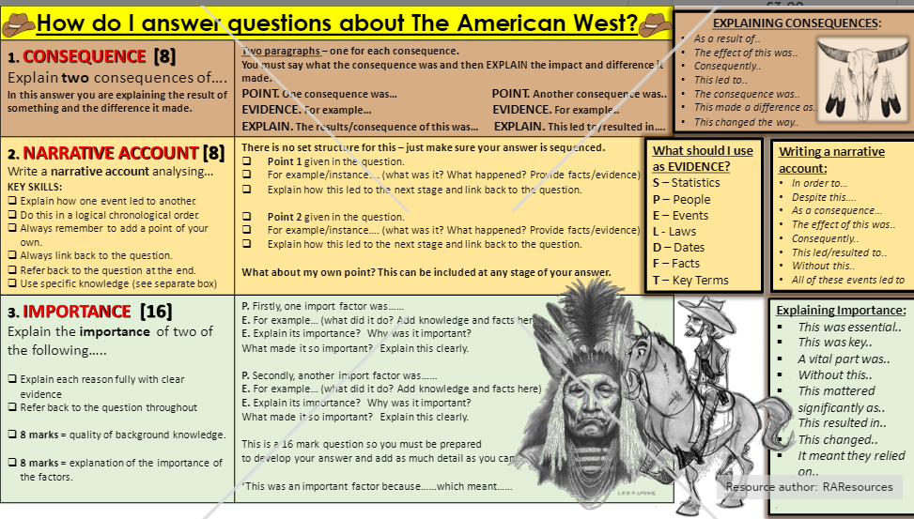

Slide 2
Narrative Question
Consequence Question
Importance Question
Guidance
ChronoLink!
Sort your events paragraphs into chronological order
Link each together!
Tick off each box as you go through
Guidance
Identify & Explain
Cleary identify two consequences
Explain each using examples and detail
Tick off each box as you go through
Guidance
Identify & Explain
Choose two reasons it was important
Explain each using examples and detail
Tick off each box as you go through
Paragraph One
Introduce the first event
Explain using specific detail (dates/facts)
Use analytical phrases ‘this led to’
Make a link to the next event
Paragraph One
Identify your first consequence ‘One consequence of…..was...’
Give two pieces of specific evidence to explain your point.
Use analytical language such as ‘this led to’
Introduction
Briefly introduce the event/person in a sentence or two
Paragraph One
Explain your first reason it was important ‘One reason…..was important is.....’
Give two pieces of specific evidence to explain your point.
Paragraph Two
Introduce the second event
Explain using specific detail (dates/facts)
Use analytical phrases ‘as a result’
Make a link to the next event
Paragraph Two
Identify your second consequence ‘A further consequence of..... ...was...
Give two pieces of specific evidence to explain your point.
Use analytical language such as ‘therefore’
Paragraph Two
Explain your second reason it was important ‘A second reason ...was important is...’
Give two pieces of specific evidence to explain your point.
Paragraph Three
Introduce the third event
Explain using specific detail (dates/facts)
Use analytical phrases

